Slide 1

Full Consignor Guide:
5 Steps to Sell Like a Rock Star with
Just Between Friends

Slide 2
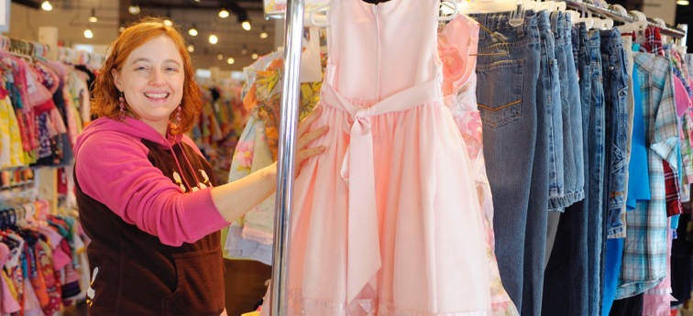
Hey there, Rock Star!
Are you ready to clean up and ca$h in?
We are here to help! Follow along to be a Super Star Consignor in no time!

Slide 3
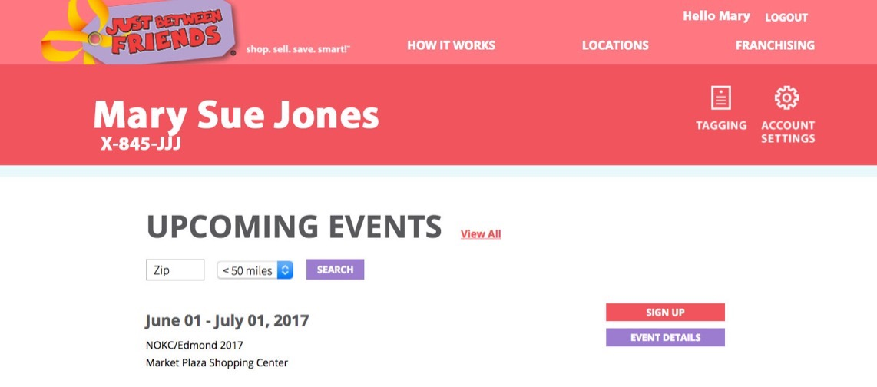
Before getting started, make sure you are registered to sell at okc.jbfsale.com
You will need to register as a consignor for each event. That points your tags to the correct event each season, so you can track your sales.

Slide 4
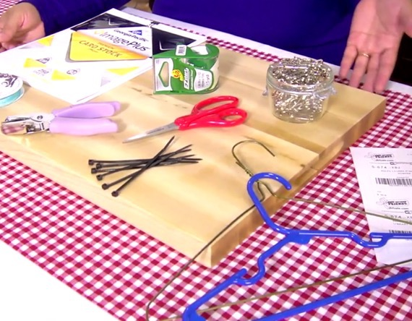
Some supplies to have handy for Selling:
STANDARD TAGGING SUPPLIES:
• Computer or mobile device
• Printer*
• White card stock (60lb+)
• 1.5 - 2 inch safety pins
• Plastic hangers (child and adult)
• Gallon & quart clear ziploc bags
• XL Ziploc/storage bags (Dollar Store!)
• Clear packing tape (I like Duck brand)
• Ribbon, string or zip-ties
• Scissors
OPTIONAL SUPPLIES:
• Tagging gun & barbs
• Paper cutter
• Cleaning supplies such as Magic Eraser, stain remover, bleach pen, wrinkle releaser and odor
remover—all are helpful!
*No Printer? No Problem!
When you finish creating your tags, use the “Print PDF” option and save the PDF file. Printing your tags at an office supply store will save you ink and time. Don’t forget to ask them to cut your tags!

Slide 5

Step 1:
GATHER

Slide 6
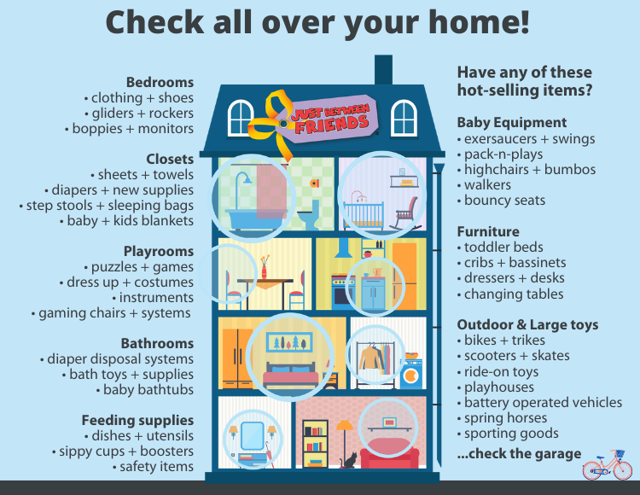
All the stuff can be overwhelming!
Growing children go through a new wardrobe every 6 months, so it’s no surprise we can feel overwhelmed!
That’s a sign that it’s time to clear out everything no longer worn or used. Check seasonal guidelines on the website for what’s in and what’s out each season.
Look all around your home—let’s get busy!
It feels so good to clear the clutter. Ahhhh…it will totally be worth it!
Notes:
NOTE to Franchisees: You can find this house infographic in DesignOnline—you may edit all the text shown in the graphic.

Slide 7
The things we can not accept
Thanks for understanding! This will help with safe distancing at the sale.
No Maternity, juniors, or adult clothing
No DVDs
No Breastpumps
No Backpacks, Lunchboxes, and purses
No Miscellaneous
Arts & Crafts
(must be in a boxed set)
No Party Supplies
No Parenting Books
No Bedding sets*
*Individual blankets are fine but they must be secured to a hanger. They will be hung under the newborn clothing.
Can accept the following:
changing pad covers, mattress protectors, and sheets (bassinet, crib, toddler, kid themed twin/full)
Must be on a hanger.

Slide 8

Step 2:
KEEP • SELL • TOSS

Slide 9
Have a stack of items ready?
Great! Grab 3 totes, baskets, or boxes and let’s sort.

Slide 10

KEEP
These are items you are not quite ready to let go of just yet. That’s perfectly fine!
We all keep a few treasures.

Slide 11
SELL
Items sell best when they meet the 4 C’s:
Clean: The newer it looks, the better it sells! Check carefully for stains, holes, rips, tears to make sure items are clean, fresh, and in good condition.
Current: Sell clothing, shoes, and items in the correct season—check out the seasonal clothing list on the website. Shoppers are looking for current styles and fashion!
Complete: toys, games and puzzles must be sold as a complete set.
Compliant: Check important safety guidelines on jbfsale.com. Let’s help keep all our children and families safe.

Slide 12

TOSS
Ah yes. We all know there is such a thing as too well loved. These items have holes, rips, tears, missing pieces. These items can be recycled or donated.
TOSS

Slide 13
Step 3:
PRICE

Slide 14
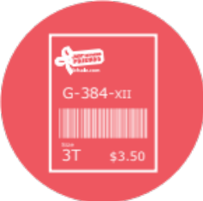

Pricing: You set your price.
Now that you have a stack of items you want to SELL, it’s time to PRICE them.
So, how to price?

Slide 15

Be shopper-focused.
Ask, “What price would make me buy this item without a second thought…and then brag about my bargain to my friends?”

Slide 16
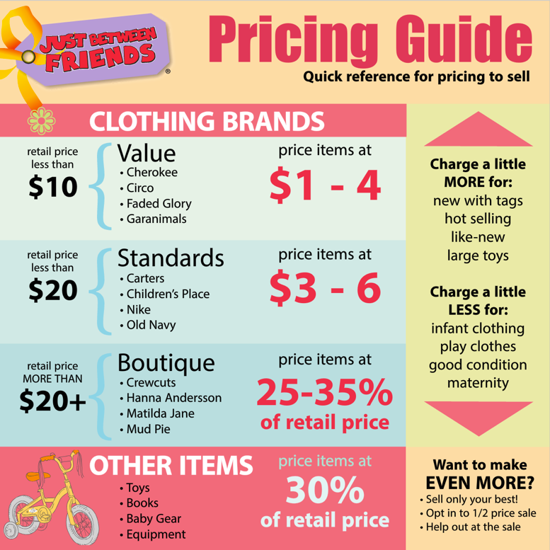
Price items according to this guide.
Make sure you are priced 50-90% below retail prices to appeal to savvy bargain shoppers.
Items priced BEST sell FIRST.
Notes:
NOTE to Franchisees: You can find this house infographic in DesignOnline—you may edit all the text shown in the graphic.

Slide 17
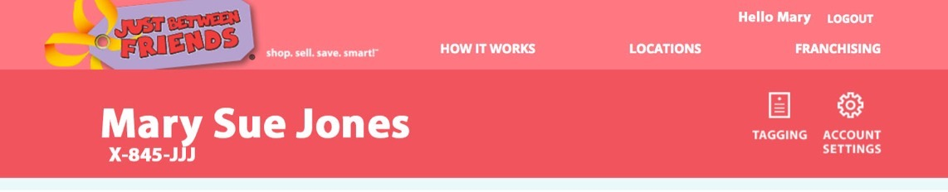
Pricing: Create your tags
Now that you’ve thought about your pricing, grab your items and log into your JBF profile on the website.
Click the TAGGING button at the top of the page.

Slide 18
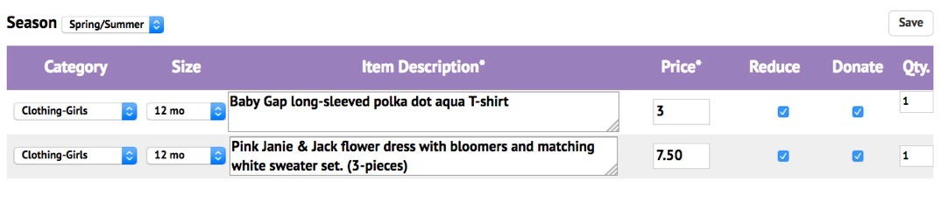
Pricing: Enter your tags
Select “Create Tags” to get started.
Choose the SEASON (this helps you organize your tags).
Choose the category and size of your item (double check that you entered the correct size).
Enter a detailed description and set your price.

Slide 19
Pricing: Select Preferences
Select (click box) if you want to:
  REDUCE: items will be discounted at the end - highly recommended to sell all your items.
  DONATE: Clicking this box means unsold items will go to local charities if they do not sell. We sort all items for pick up so don’t worry if you change your mind.
  You can set your account to automatically reduce and/or donate. Go to ”MY SETTINGS” to update.

Slide 20
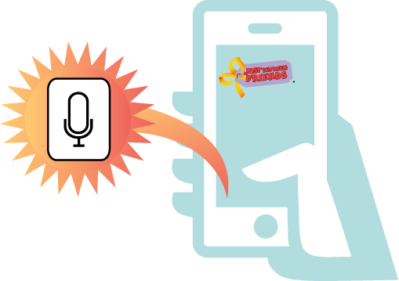
Pricing: Talk-to-Text TIP!
Use your smart phone’s speaker function to enter tags even faster!

Slide 21
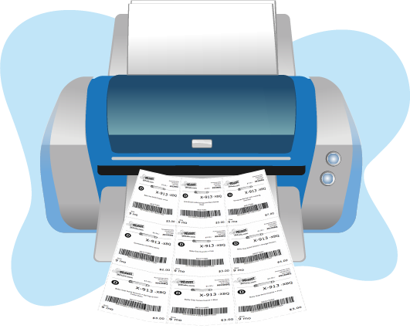
Pricing: Print your Tags
PRINT your tags on white cardstock
Tip: After you print, number each tag so you can put the tags in order after you cut -use a pencil and put the number in an inconspicuous place. This will make your next step faster!

Slide 22

Step 4:
PREP

Slide 23

Prep: Grab tags & supplies
Following is what you need to know about
attaching tags, packaging non-clothing items, and
hanging clothes like a PRO!
    Start with your biggest selling items FIRST to ensure that you will make a good return on your time. Separating items by size and category will help too.

Slide 24
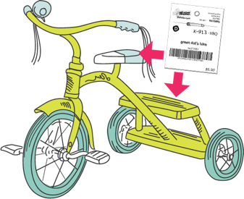
Prep: Toys & Gear
Getting these items as clean as you can will help them SELL. A Magic Eraser and some elbow grease go a long way.
Also, check to make sure there are no recalls for these items. Attach your tag to the item with clear tape or punch a hole in the tag and fasten with a zip-tie—if you punch a hole in the tag remember to reinforce it with tape.

Slide 25
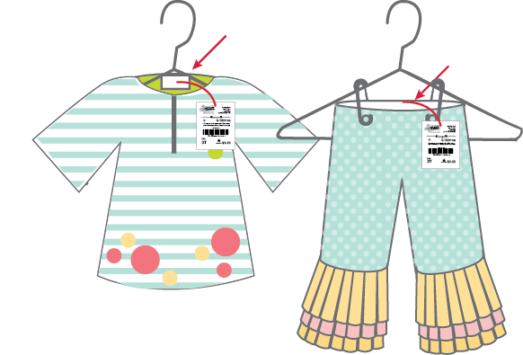
Prep: Clothing
Make sure your items are clean—and smell good!
A squirt of fabric refresher can go a long way. Using Downy Wrinkle Release, too, will help smooth items—or, you can toss them in the dryer to help get wrinkles out too.
Grab a hanger and hang your item with the hanger making a question mark.
Pin your JBF tag to the right upper side. If using a tag gun attach to size tag or inside middle seam.
Using a tagging gun can help speed things along. Just make sure the tag can be easily seen at the top of the item. And don’t make a hole through clothing.
For items like socks or tights, bag them together and tape your tag to the bag using clear tape.

Slide 26
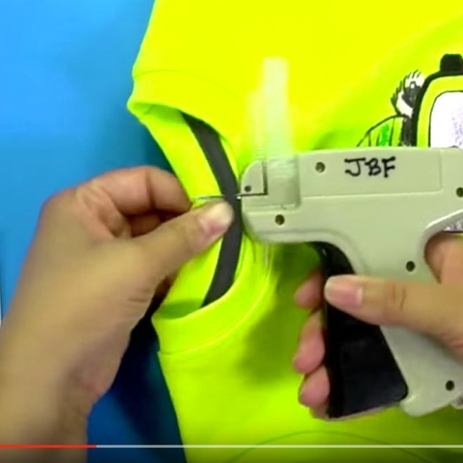
Prep: Using a Tagging Gun
Tagging guns are AWESOME! BUT make sure you secure the tag through an inside seam so the item will not have a hole in it. Test on an old item first.
    Don’t place tags under the
    arm pit or on a side seam.
    Tags that dangle are hard for us to scan and sort - and kids tend to rip them off.

Slide 27
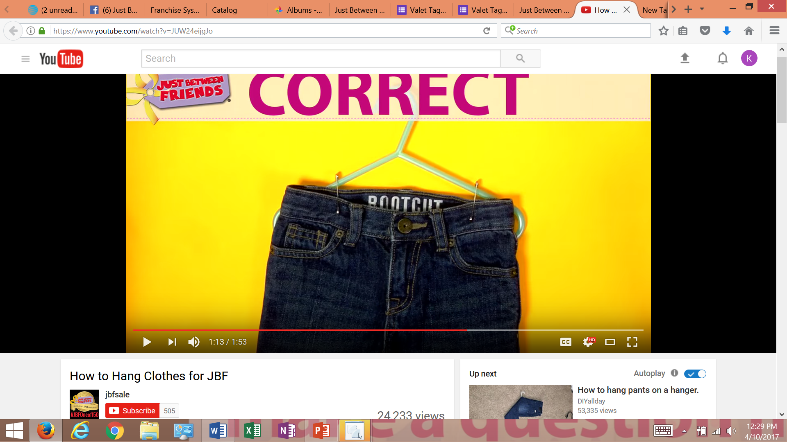
Prep: Pants & shorts
Make sure pants and shorts are attached to the top of the hanger.
Go through the MIDDLE of BOTH areas of the waistband to keep the pants from gaping and sliding to the bottom.

Slide 28
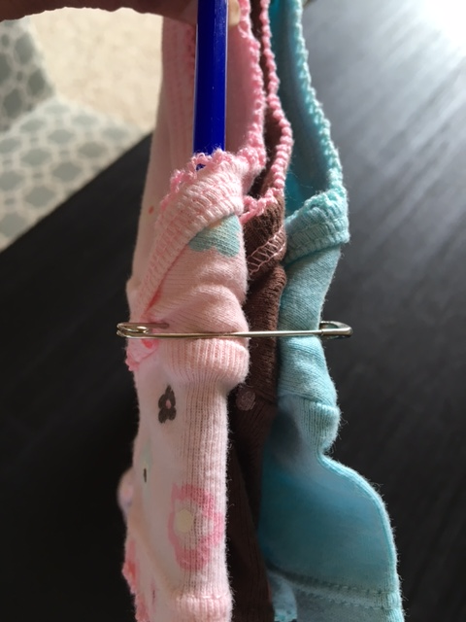
Prep: Multi-Piece Clothing
Position both items on one hanger so you can pin them together as a set. All pieces must be pinned together.
Sets sell well at our sale! Just make sure the items are THE SAME SIZE and secured to the hanger.
Safety Pin through all the pieces and around the hanger to give support and prevent a tear.

Slide 29
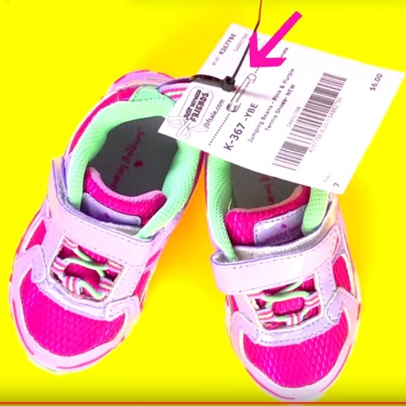

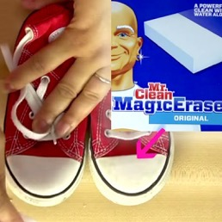
Prep: Shoes
Hole-punch your tag and use a zip-tie to secure both shoes and tag together.
Remember to reinforce the tag with tape before you punch a hole in it – we want to keep your items secure. For shoes that cannot be zip-tied, use a safety pin or place in a clear bag. Most shoes have a spot to zip-tie – get creative.
Magic Erasers take off scuffs and help shoes (and other items) sell!

Slide 30
Prep: Books
It is best to sell books individually. If you have a set of books place them all in a large Ziploc bag and seal the bag with tape. Do not tie or tape books together since they can be easily separated and damaged this way.
Use clear tape or blue painters tape to attach tags to items. Cover the book barcode with your barcode tag (this helps us at check out).
REMINDER: We no longer accept DVD’s

Slide 31

Prep: Keep it Safe!
One of the great things about our sale is that Just Between Friends is the only event in the industry to employ a safety and recall specialist! We work to keep families safe.
Please check our website to make sure ALL your items are safe to sell.

Slide 32
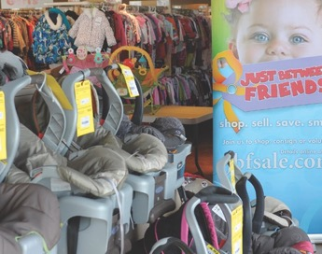
Prep: Selling a Car Seat or Crib?
Make sure you print and sign our WAIVER and bring that with you to the sale!
It’s located on the How to Sell page on the website okc.jbfsale.com
Now…you are ready for the last step!

Slide 33

Step 5:
DROP OFF

Slide 34
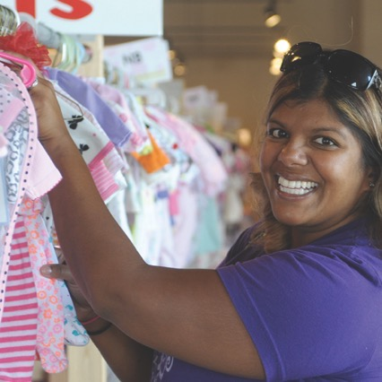
Drop Off: Pack it up, drop it off.
Now that you’ve priced, tagged, and prepped, you’re ready to drop off!
    Keep items organized by size and type to speed things up during the drop off process. Things have a way of shifting around in transit! A few rubber bands can help keep hangers together in the car!

Slide 35
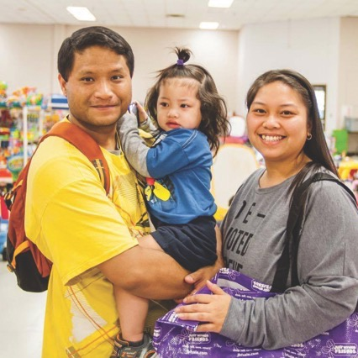
Drop Off at State Fair Park
Consignor Drop Off Times:
Click here to schedule your drop off time
Thursday, August 15
2pm-5pm – Perfect Consignors only
5pm-8pm - ALL Consignors
Friday, August 16
10am-2pm - ALL Consignors

Slide 36
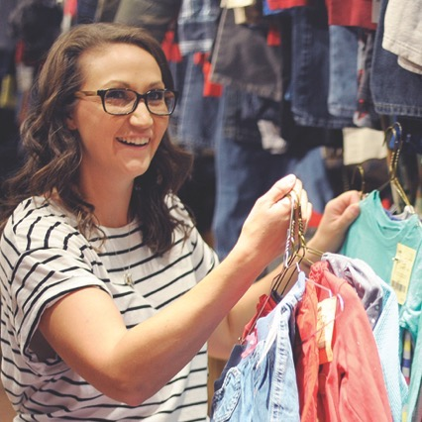
Drop Off: What to expect
1. Drive up and look for the JBF crew on the side of the building. Items you want unloaded must be in tubs or boxes. Clothes do not need to be in boxes but organized so we can help you unload your items quickly. Drive Large items to the back loading door.
2. Create and Print 2 barcode tags to bring with you‼️
➜ just 2 tags not 2 sets
Enter this in the description when creating the tag (or write it in)
➜ First and Last Name, cell phone number, and email address
Tag #1 will be left at the check in desk as you walk in the door. instead of waiting in line to check in and verify your information, you leave your tag in a basket and move on to inspections.
Tag #2 will be left with your clothes during inspection. Then you can place your
non-clothing items on the sales floor. The inspector will text when clothes are ready for you to place on the racks. (Perfect Consignors bypass this step).
3. After inspection, you will place all items on the sales floor, so plan to allow 60-90 minutes depending on how many items you are selling.

Slide 37

Other good stuff to know:
You can check you’re MY JBF TAGS site to see which items have sold.
Your check will be emailed 14 days after the sales event closes (often times quicker)!
Consignors earn up to 80% on their sold items
60% - base consignor percentage
70% - do at least one shift
80% - do at least one shift + choose to receive your check in JBF bucks to use at a future event. This would be in lieu of a traditional check. We will give you the option before checks are sent!

Slide 38
Remember to reserve your PRESALE TIME!
After you register to consign, you will receive an email with a link and code to reserve your consignor presale tickets.
SHOP EARLY TIME: Saturday, August 17
Tickets are limited – get yours now!
As a consignor, you have earned this perk,
plan to shop early—you will get one friend pass too!
Children under age 16 are not allowed to attend any presales. The only exception is for babies under 6 months. Strollers are fine!

Slide 39
Picking up Unsold Items?
If you want to PICK UP unsold items (meaning, you chose not to donate unsold items), you must reserve a PICK-UP time
Saturday, August 24 from 7:00pm-8:30pm
RESERVE YOUR PICK-UP TIME HERE
After this time, all items, without exception, will be donated to our charity partners, Infant Crisis Services and Christmas Connection.

Slide 40
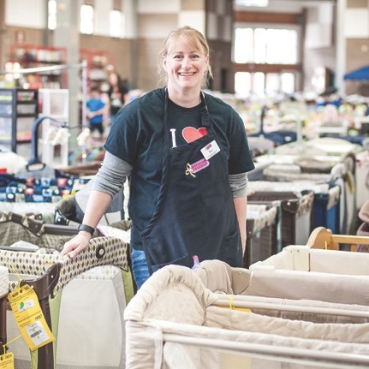
Want to shop even earlier?
Our earliest shoppers are those who join our JBF TEAM and help at the sale!
The team member presales are scheduled for
Saturday, August 17
Here's the scoop:
9:00am: 20 Hours
10:00am: 8 Hours
11:00am: 4 Hours
ANOTHER PERK: You earn an extra 10% on items you sell

Slide 41

That’s it! You’re done! HOORAY!

Slide 42


Got questions?
Please ask!
I want you to have all you need to sell successfully with JBF of OKC!
Email: kathy@jbfsale.com
Phone/Text: 405-388-1731
Facebook Page: facebook.com/JBFofOKC
Thanks for being a part of our sale!

